Slide 1
Predicting Dynamic Embedding Trajectory in Temporal Interaction Networks
SRIJAN KUMAR,XIKUN ZHANG,JURE LESKOVEC
報告人:王樸
指導教授:戴碧如

Slide 2
outline
Introduction
Related work
JODIE: Joint Dynamic User-Item Embedding Model
Experiments
Conclusion

Slide 3
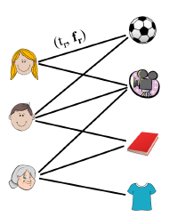
Introduction overview
Users interact sequentially with items in many domains such as e-commerce (e.g., a customer purchasing an item) ,education (a student enrolling in a MOOC course) ,and social and collaborative platforms (a user posting in a group in Reddit)
The same user may interact with different items over a period of time and these interactions change over time
Notes:
temporal interaction network
其中t :time stamp
f:feature

Slide 4
Introduction Representation learning
Representation learning, or learning low-dimensional embeddings of entities, is a powerful approach to represent the evolution of users’ and items’ properties
Four fundamental challenges
How to accurately predict the embedding trajectories of users/items as time progresses
It is essential to consider stationary properties that do not change over time and time evolving properties
Methods are required that can recommend items in near-constant time
Methods are needed that can be trained with batches of data to generate embedding trajectories.
Notes:
四個基本的挑戰:
1.如何隨時間正確的預測 embedding trajectories of users/items:
只在使用者有動作時進行embedding:會導致以後使用者再回來平台時,預測和推薦的東西都一樣,但使用者的意圖可能已經改變了,所以embedding得隨時間改變
2.同時考慮不隨時間改變的property和會隨時間改變的property
3.方法要可以在接近常數時間就可以推薦item
4.方法要可以用批次訓練產生embedding trajectories(大部分方法 適用sequentially 的方式處理interaction,所以在interactions 之間會產生temporal dependencies)

Slide 5
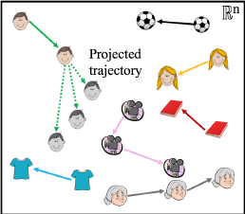
Introduction JODIE: Joint Dynamic User-Item Embedding Model
Learns to generate embedding trajectories of all users and items from temporal
interactions
The embeddings of the user and item are updated when a user takes an action and a projection operator predicts the future embedding trajectory of the user
Notes:
user 和 item 的embedding
trajectory
作者會train projection operator 去預測user未來的trajectory

Slide 6
outline
Introduction
Related work
JODIE: Joint Dynamic User-Item Embedding Model
Experiments
Conclusion

Slide 7
Related work
Deep recurrent recommender models
Recent methods, such as Time-LSTM and LatentCross learn how to incorporate features into the embeddings
Dynamic co-evolution models
Methods that jointly learn representations of users and items have recently been developed using point-process modeling and RNN-based modeling
Temporal network embedding models
Several models have recently been developed that generate embeddings for the nodes (users and items) in temporal networks
Notes:
Deep recurrent recommender models
缺點:
1.使用item 的one-hot vector 更新user embedding,忽略了item 的current state
2.只產生user的dynamic embedding(item 沒有)
Dynamic co-evolution models
basic idea和jodie很像,user 和item embeding每當他們interact 時會互相影響
和jodie不同的是,Jodie output item embedding 而不是interaction的機率,train model時事使用batching的方式,所以結果和速度都比較好
Temporal network embedding models

Slide 8
outline
Introduction
Related work
JODIE: Joint Dynamic User-Item Embedding Model
Experiments
Conclusion

Slide 9
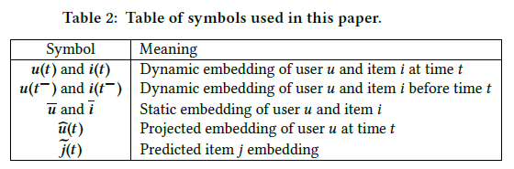
JODIE: Joint Dynamic User-Item Embedding Model
JODIE, a method to learn embedding trajectories of users u(t) ∈ R^{n} ∀u ∈U and items i(t) ∈ R^{n} ∀i ∈ I,∀t ∈ [0,T] from an ordered sequence of temporal user-item interactions S_{r}=(u_{r},i_{r},t_{r},f_{r})
Types of embeddings:
Static Embedding
Stationary properties such as the long-term interest of users
Dynamic Embedding
These embeddings change over time to model their time-varying behavior and properties

Slide 10
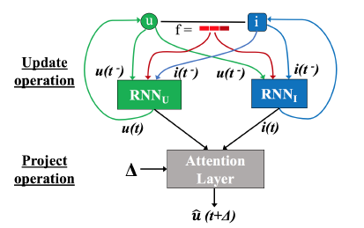
JODIE Embedding update operation
u(t) =σ(W₁^{i} u(t⁻) + W₂^{i} i(t⁻) + W₃^{u}f + W₄^{u}Δ_{u}
i(t)=σ(W₁^{i} i(t⁻) + W₂^{i} u(t⁻) + W₃^{i}f + W₄^{i}Δ_{I}
Δ_{u}: time since u’s previous interaction
Δ_{i}: time since item i’s previous interaction
f:the interaction feature vector
W:parameter
The matrices W are trained to predict the embedding of the item at u’s next interaction
Notes:
此設計比起使用items’ one-hot vector 更新user embedding 好
原因:
1.one-hot vector 只包含 item id 並不包含item current state
2.data set很大的時候 維度會非常大
所以作者使用item 的dynamic embedding 反映出item 的current state 可以導致更有意義的user embeding 以及更容易training
同理,在RNNi中也用dynamic user embedding u(t−) update dynamic embedding i(t )

Slide 11
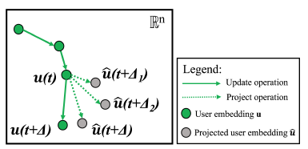
JODIE Embedding projection operation
Predicts the future embedding trajectory of the user
Done by projecting the embedding of the user at a future time
Two inputs are required for the projection operation: u’s embedding at time t and the elapsed time Δ.
We first convert Δ to a time-context vector w ∈ R^{n} using a linear layer (represented by vector W_{p}): w = W_{p}Δ
projected embedding:

Slide 12
JODIE Training to predict next item embedding
Let u interact with item i at time t and then with item j at time t +Δ
We train JODIE to make this prediction using u’s projected embedding
Output:
Reducing the computation at inference time
We make this prediction using the projected user embedding and the embedding
of item I
The prediction is made using a fully connected linear layer as follows:
Notes:
若以機率方式output interaction 的話則要做item 個數 次的 neural-network forward pass
找到最高互動機率的item
JODIE只需要做一次forward pass 就可以了
||predicted item embedding-real item embedding||
B:bias vector

Slide 13

JODIE Training to predict next item embedding
Minimize the L2 difference:
Notes:
後面兩項regularize loss 以及預防user and item 的consecutive dynamic embeddings 差異太大
λU and λI are scaling parameters to 確定loss在同一格range

Slide 14
JODIE t-Batch: Training data batching
Parallelize the training of JODIE: train JODIE using a training data batching algorithm
Two challenge:
All interactions in each batch should be processed in parallel
Processing the batches in increasing order of their index should maintain the temporal ordering of the interactions and thus
t-Batch creates each batch by selecting independent edge sets of the interaction network
JODIE works iteratively in two steps:
select step
reduce step
Notes:
大部分這種使用mutually-recursive
RNNs的RNN 以sequential的方式一次處理一個interaction
速度很慢
independent edge sets:
兩個interaction 沒有共同user 以及item
select step:
選取maximal edge set 當成一個new batch,其中這些edge 是lowest time stamp incident
這個方法可以使選到的 batch 為獨立的edge set
reduced step:
把選到的edge remove
JODIE重複這過程直到沒有EDGE在network 中

Slide 15
outline
Introduction
Related work
JODIE: Joint Dynamic User-Item Embedding Model
Experiments
Conclusion

Slide 16
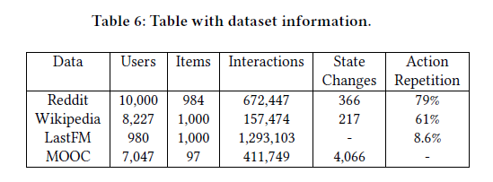
Experiments
We experimentally validate the effectiveness of JODIE on two tasks]
Future interaction prediction
User state change prediction
Thus, we train all models on the first τ% interactions, validate on the next τ_{v}%, and test on the
last remaining interactions

Slide 17
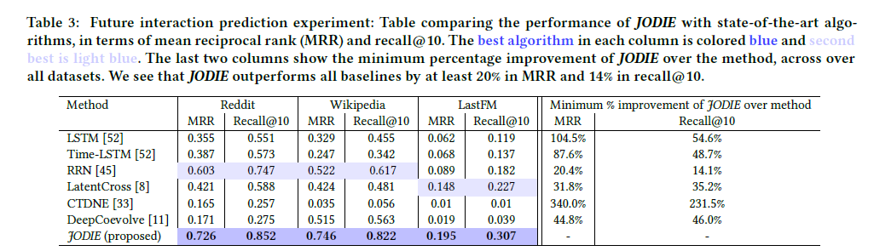
Experiments Future interaction prediction

Slide 18
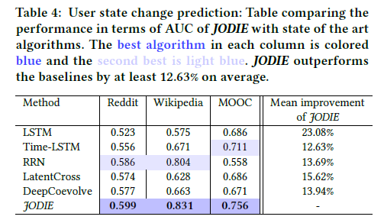
Experiments User state change prediction

Slide 19
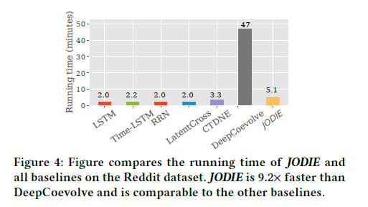
Experiments Runtime experiment

Slide 20
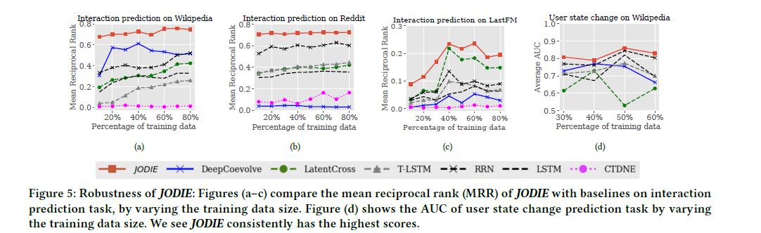
Experiments Robustness to the proportion of training data

Slide 21
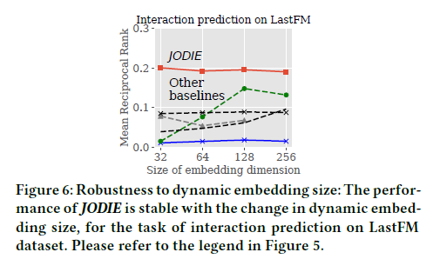
Experiment Embedding size

Slide 22
outline
Introduction
Related work
JODIE: Joint Dynamic User-Item Embedding Model
Experiments
Conclusion

Slide 23
Conclusion
Coupled recurrent neural network model called JODIE that learns dynamic embeddings of users and items from a sequence of temporal interactions
JODIE learns to predict the future embeddings of users and items, which leads it to
give better prediction performance of future user-item interactions and change in user state
We also presented a training data batching method that makes JODIE an order of magnitude faster than similar baselines.
Future work:
Learn trajectories for groups of users or items to reduce the number of parameters
Characterizing the trajectories to cluster similar entities

Slide 24
Comment
Good way to embedding user and item interaction

Slide 25
Q&A

